Slide 1

Optimizing Performance: Advanced Maintenance and Repair Techniques for 3-Phase Electrical Motors

Slide 2

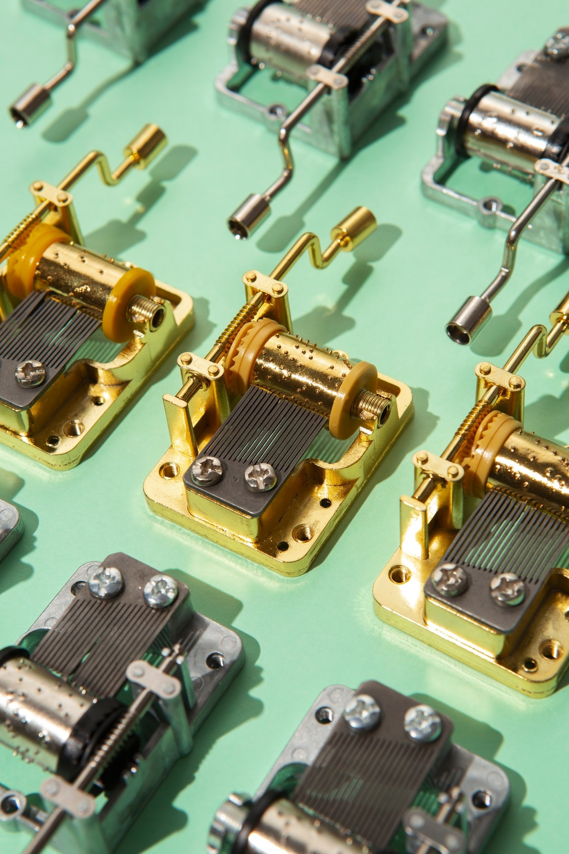
Introduction to 3-Phase Motors
3-phase electrical motors are widely used in industrial applications due to their efﬁciency and reliability. This presentation explores advanced maintenance and repair techniques to optimize their performance, ensuring longevity and reduced downtime.

Slide 3

Understanding 3-Phase Systems
A 3-phase system consists of three alternating currents that are offset by 120 degrees. This design allows for a smoother and more efﬁcient operation, which is crucial for high-performance motors in various applications.

Slide 4


Common Motor Failures
Common issues in 3-phase motors include overheating, bearing failures, and winding shorts.
Identifying these problems early can prevent costly repairs and ensure optimal motor performance.

Slide 5
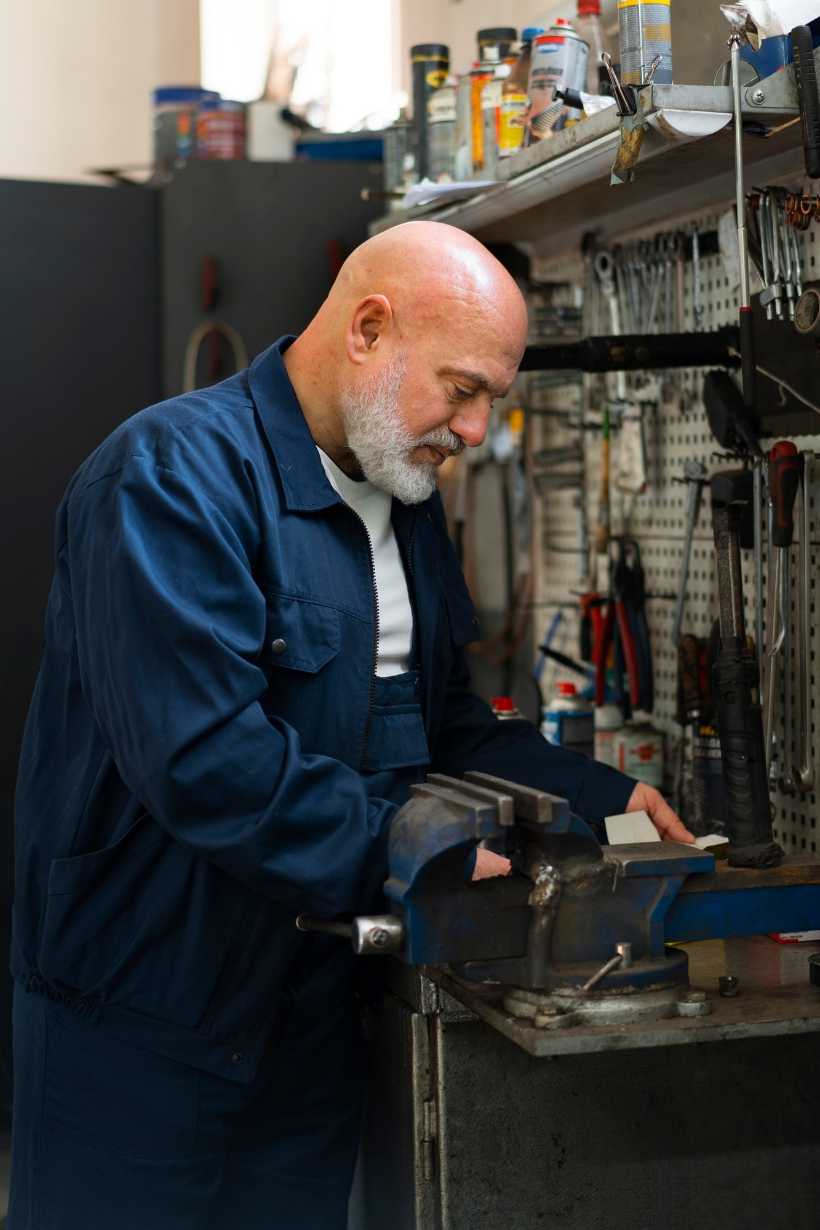
Preventive Maintenance Strategies
Implementing a preventive maintenance schedule is essential. Regular inspections, lubrication, and cleaning can signiﬁcantly reduce the risk of failures, extending the lifespan of 3-phase motors.

Slide 6


Vibration Analysis Techniques
Utilizing vibration analysis can help detect imbalances and misalignments in motors. This technique allows for early intervention, preventing more severe issues and maintaining peak performance.

Slide 7

Thermal Imaging Applications
Thermal imaging is a valuable tool for identifying overheating components in 3-phase motors.
This non-invasive technique helps in pinpointing issues before they lead to failures.

Slide 8

Electrical Testing Methods
Conducting electrical tests such as insulation resistance and winding resistance tests is crucial. These tests identify potential electrical issues that could compromise motor performance.

Slide 9

Lubrication Best Practices
Proper lubrication is vital for reducing friction and wear in motor bearings. Understanding the right type and frequency of lubrication can greatly enhance the operational efﬁciency of 3-phase motors.

Slide 10

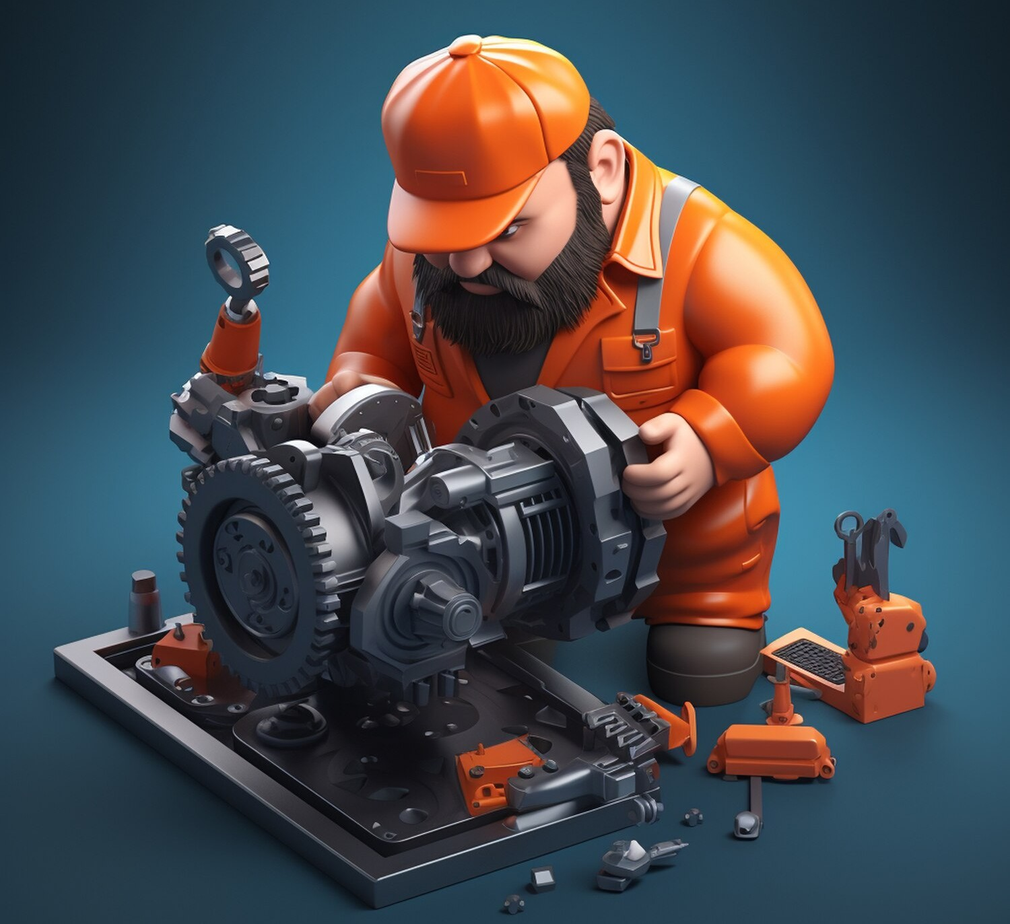
Repair Techniques Overview
Advanced repair techniques such as rotor rewinding and bearing replacement can restore motor functionality. Knowing when to repair versus replace is key to cost-effective maintenance.

Slide 11
Monitoring Performance Metrics
Establishing a system for monitoring performance metrics like speed, torque, and efﬁciency can help in assessing the health of 3-phase motors and optimizing their operation.

Slide 12

Case Studies in Optimization
Reviewing case studies of successful motor maintenance and repair can provide valuable insights. These examples highlight effective strategies that led to improved performance and reduced downtime.

Slide 13

Conclusion and Best Practices
In conclusion, optimizing 3-phase motor
performance requires a combination of advanced maintenance techniques and regular monitoring. Implementing these practices will lead to enhanced reliability and efﬁciency.

Slide 14




Thanks!
Do you have any questions? addyouremail@freepik.com
+91 620 421 838
yourcompany.com

